Slide 1
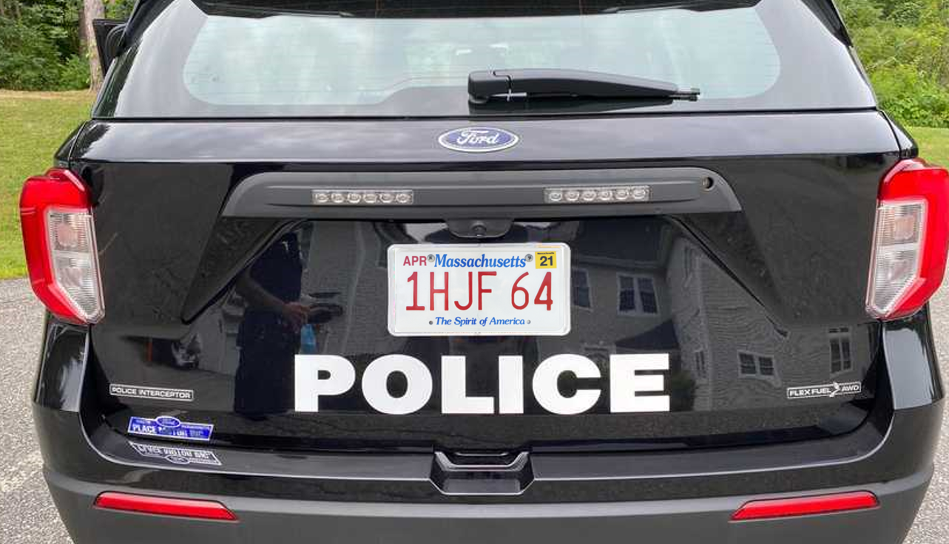
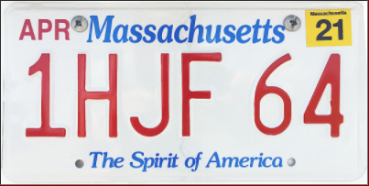



NN
Is this rectangle a car plate?
Rectangle
detection
candidates
Size/Shape Filter
Extract top and bottom parts
- Grayscale
- Edge detection - Binarization
NN
Character recognition
Character segmentation
Sequence extraction
1 H J F 6 4
NN
Which State is this plate from ?
RGB/HSV Info
MA

